Slide 1

Image Caption Generator Using CNN–LSTM Encoder–Decoder Architecture

Slide 2
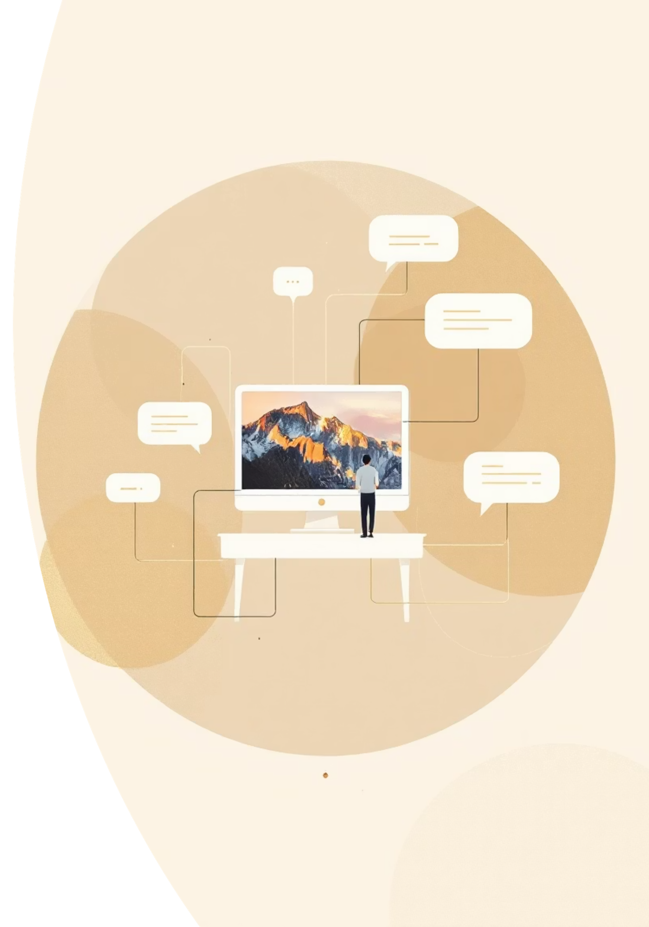
The Challenge: Teaching Machines to "See" and "Describe"
Bridging the Gap
Automated Captioning
Images hold vast visual information, but for computers, they are merely pixels. The core challenge is transforming raw pixel data into meaningful, human-understandable language.
Our primary objective is to develop systems that can automatically generate descriptive natural language captions for any given image, mimicking human perception and articulation.
Diverse Applications
This technology opens doors to critical applications like enhancing accessibility for visually impaired users, automating social media tagging, and improving image content search capabilities.

Slide 3

Why Combine CNN and LSTM?
CNN: The Visual Analyzer
LSTM: The Language Narrator
Convolutional Neural Networks are exceptionally skilled at processing visual data.
Long Short-Term Memory networks are a specialized type of Recurrent Neural Network.
They excel at extracting spatial features, recognizing patterns, objects, and textures within images.
Designed to handle sequential data, making them perfect for generating coherent and contextually relevant sentences.
Acts as the "eyes" of the system, identifying what's present in a scene.
Functions as the "voice" of the system, translating visual insights into descriptive text.
The synergy of CNN and LSTM creates a powerful architecture: the CNN encodes the image's visual features, and the LSTM then decodes these features into descriptive, fluent sentences.

Slide 4
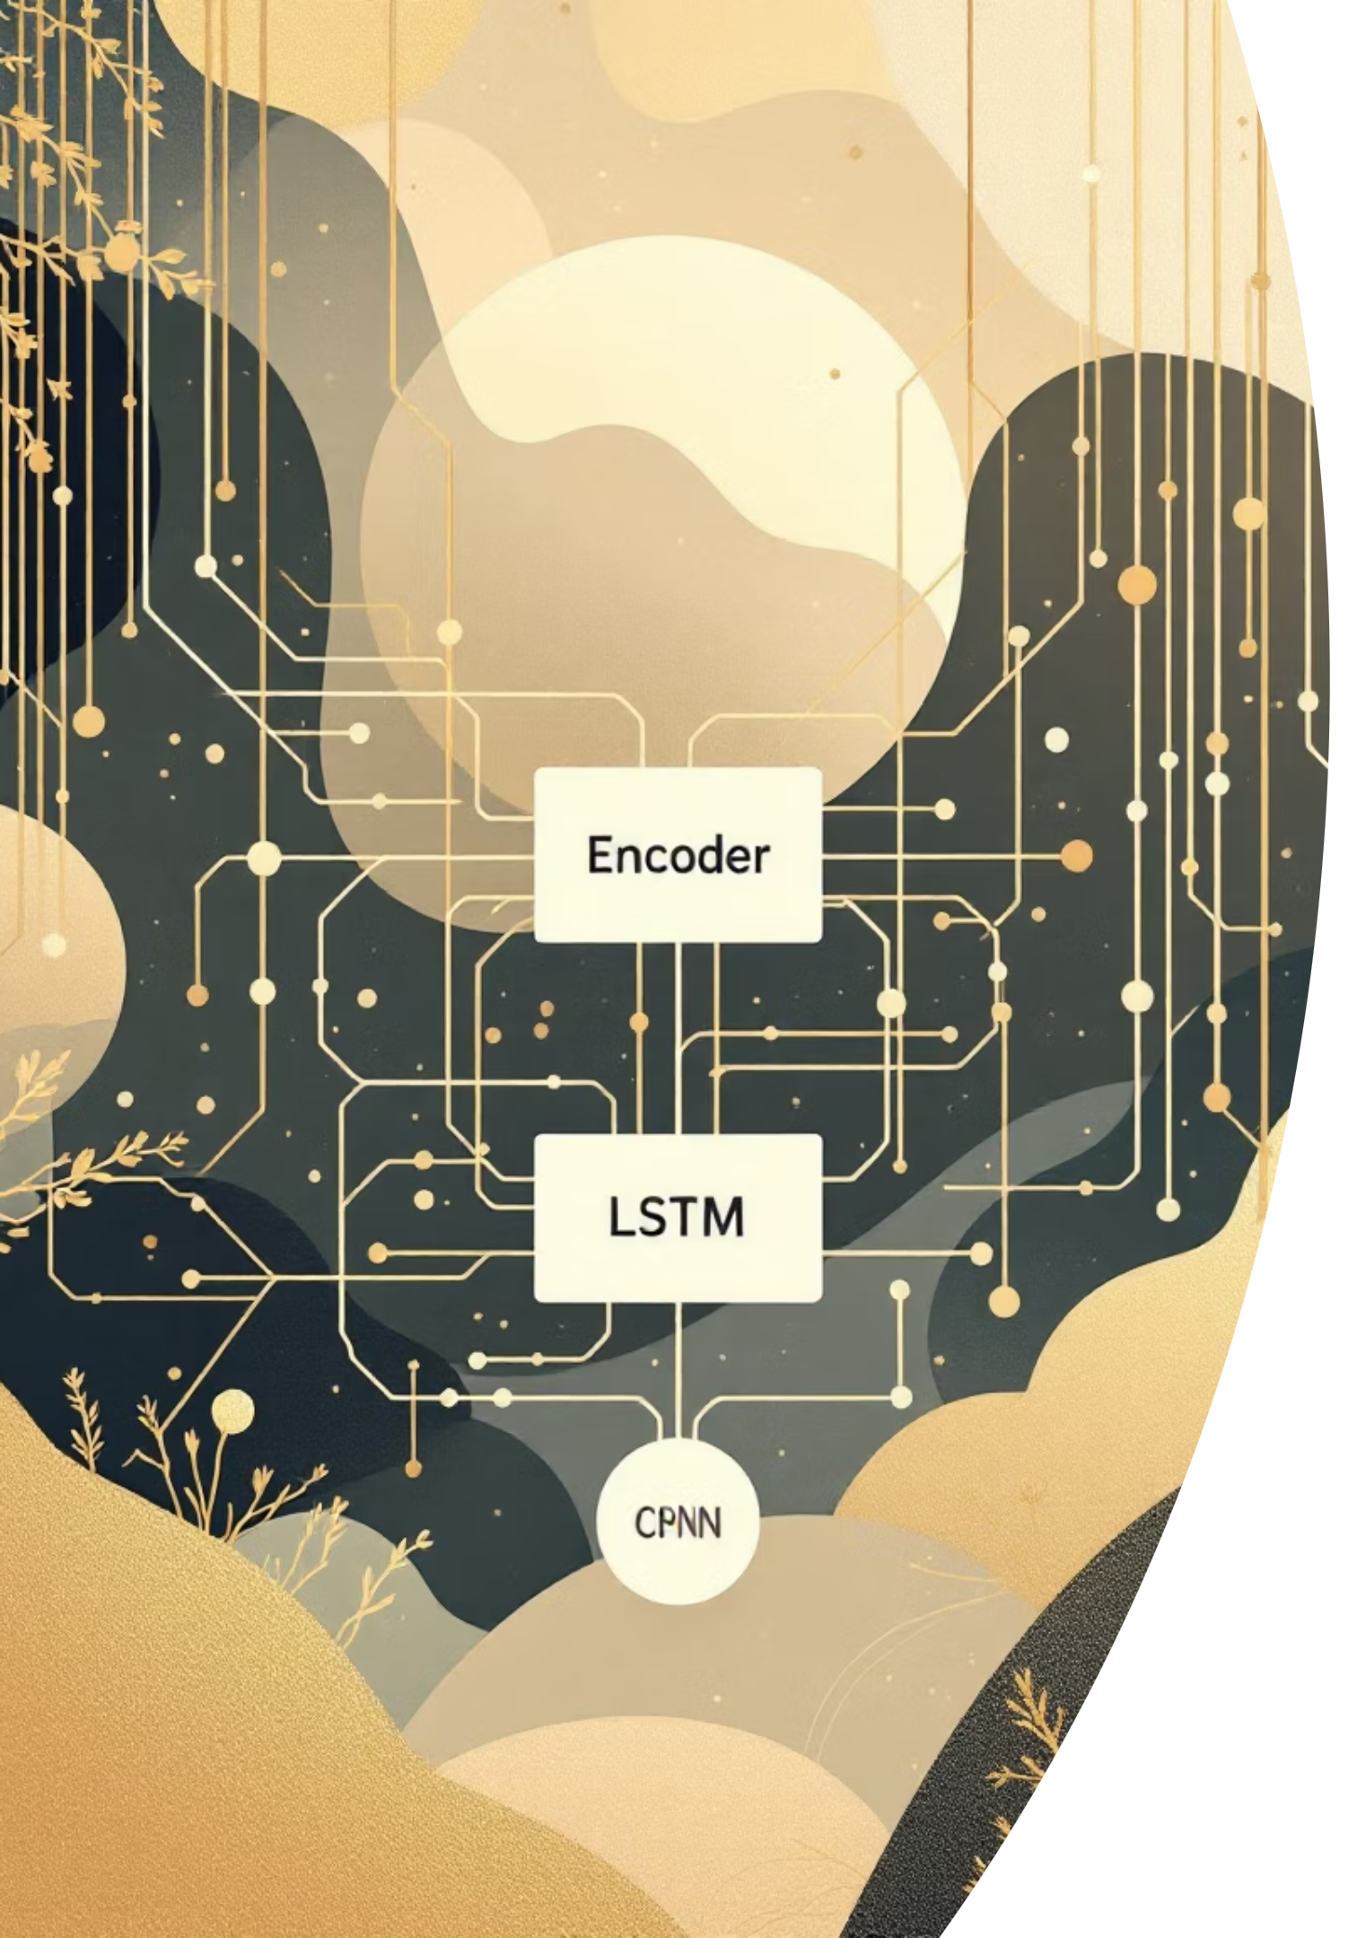
Architecture Overview: Encoder–Decoder Model
01
02
Encoder: Feature Extraction
Decoder: Caption Generation
A deep Convolutional Neural Network (e.g., ResNet, InceptionV3) processes the input image. It acts as the encoder, distilling the complex visual information into a compact, fixed-length feature vector.
An LSTM network serves as the decoder. It takes the feature vector from the CNN and, leveraging its memory capabilities, predicts words sequentially. Each new word prediction is influenced by the image context and the words generated previously.
03
Training Datasets
The model is trained using extensive datasets comprising paired images and their corresponding human-generated captions, such as Flickr8K, Flickr30K, and the large-scale MSCOCO dataset. This teaches the model to associate visual patterns with linguistic descriptions.

Slide 5

Visualizing the Process: Image to Caption
Output caption
Input image
word1 ... wordN end
Raw image pixels
LSTM decoder
Image-to-Caption Flow
CNN encoder
Generates words sequentially
Extracts feature map
Start token + vector
Feature vector
Compact image representation
Initial decoder input
This visual flow illustrates how the system seamlessly transforms a raw image into a descriptive textual caption, word by word, capturing the essence of the scene.

Slide 6

Key Technical Insights
CNN: Spatial Understanding
The deeper layers of the CNN are crucial for identifying abstract features, including distinct objects, intricate textures, and the overall spatial context of the image.
LSTM: Linguistic Fluency
LSTMs are adept at maintaining long-range dependencies, ensuring that the generated captions are not just descriptive but also grammatically correct and contextually coherent.
Sequence Boundaries
Special start and end tokens are incorporated into the LSTM's input and output sequence, clearly defining the boundaries of each generated sentence.
Transfer Learning Power
Utilizing pre-trained CNNs, typically trained on massive image classification tasks like ImageNet, significantly accelerates training, boosts accuracy, and reduces the need for immense computational resources.

Slide 7
Overcoming Challenges: Avoiding Overfitting & Improving Accuracy
Data Scarcity
Model Robustness
While datasets like MSCOCO (~160k images with 5 captions each) are large, they can still be insufficient to fully capture the vastness of visual concepts and linguistic expressions. Data augmentation and diverse datasets are vital.
Techniques such as Dropout regularization prevent the model from memorizing training data. Careful hyperparameter tuning optimizes learning rates and model complexity for better generalization.
Inference Optimization
Semantic Understanding
Beam search during inference explores multiple caption possibilities, selecting the most probable sequence rather than just the greedily chosen next word, significantly enhancing caption quality.
The hidden states within the LSTM effectively encode semantic meaning, reflecting similarities between words and concepts. This allows the model to generate captions that are not just syntactically correct but also semantically rich and accurate.

Slide 8


Real-World Impact & Applications
Enhanced Accessibility
Automated captions empower screen readers, verbally describing images for visually impaired users, significantly improving their digital experience and access to information.
Social Media Automation
Platforms can auto-caption user-generated photos, streamlining content organization, improving discoverability, and enriching the overall user engagement experience.
Efficient Content Retrieval
By generating textual descriptions for images, this technology enables precise text-based search and indexing within vast image and video databases, transforming how we find visual content.
Media Industry Boost
Services like YouTube can leverage auto-captioning for video thumbnails, providing quick summaries and improving content categorization for millions of videos.

Slide 9

Recent Advances & Future Directions
Attention Mechanisms
New models incorporate attention, allowing the decoder to dynamically focus on specific regions of an image as it generates each word, leading to more contextually accurate captions.
Transformer Decoders
Replacing LSTMs with transformer-based decoders has enabled even richer language modeling and capture of intricate linguistic nuances, pushing the boundaries of caption quality.
Adaptive Captioning
The field is evolving towards multilingual captioning, generating descriptions in various languages, and style-adaptive systems that can tailor captions to specific tones or user preferences.
Edge Computing
Future developments aim for efficient, real-time captioning capabilities on resource-constrained devices like smartphones and embedded systems, bringing AI directly to the user's hand.

Slide 10


Conclusion: Bridging Vision and Language with CNN–LSTM
1
A Synergistic Approach
The CNN–LSTM encoder-decoder model stands as an elegant solution, masterfully blending the domains of computer vision and natural language processing.
2
Human-like Description
This architecture empowers machines to "see" and interpret images, generating descriptions that closely resemble human understanding and articulation.
3
Transformative Technology
Its profound impact is already visible across accessibility, media management, and the broader spectrum of AI-human interaction, making digital content more navigable and inclusive.
4
Towards Smarter Futures
The journey continues toward creating even smarter, faster, and more context-aware captioning systems, continually refining how AI interacts with and interprets our visual world.

